Slide 1

EXPLORATORY DATA ANALYSIS (EDA)
Presented By:
Fantastic Group

Slide 2
Contents
Introduction to Team and Dataset
Problem Statement
Our Work
Tools and Technology
Conclusion

Slide 3

MEET THE TEAM
IMRAN ALI SOOMRO
GUL MUNIR HASSAN
HAMNA ASIF
ZUBAIR HUSSAIN

Slide 4



INTRODUCTION TO DATASET
HEART ATTACK PREDICTION

Slide 5
Parameters
age
sex
restBP
chol
maxHR
restECG
output

Slide 6
Problem Statement
What we will achieve from EDA of this Dataset.
What is the Importance of this Dataset.
At What attributes Heart Attack depends the most.
We can observe the different attributes of Dataset.
If we decrease any attribute, then what effect will be observed on the Output.

Slide 7

OUR WORK
EDA

Slide 8
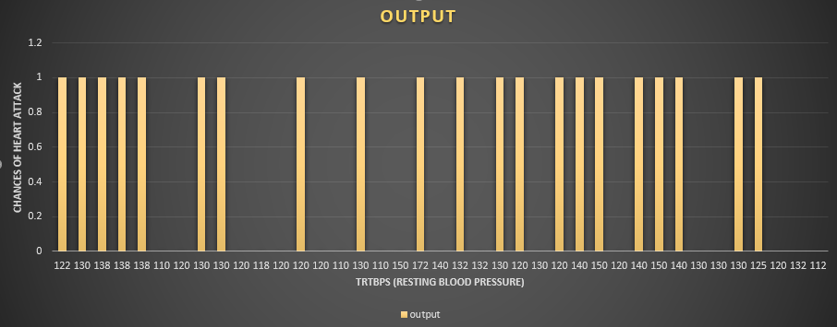
Relationship of Resting Blood Pressure with Chances of Heart Attack
Total record = 39
People having BP above 120 == 25
People having BP <= 120 == 14
People having increased chances of attack == 21
People having less or no chance of attack == 18
Normal blood Pressure = 120

Slide 9
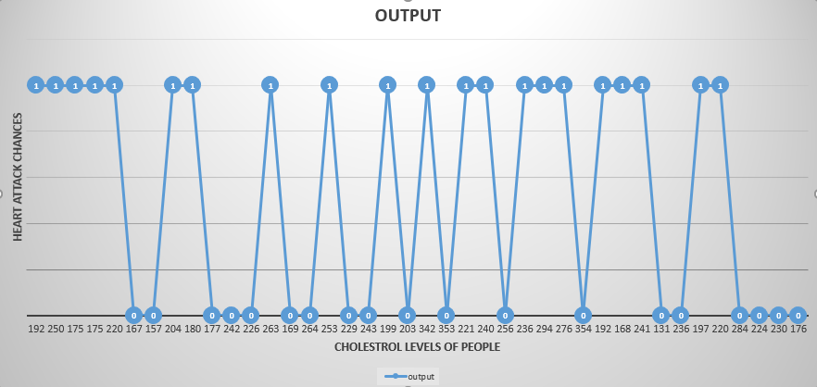
Relationship between Heart Attack Chances with Cholesterol Level
Normal Cholesterol level == 200 mg/dl
People having risk of getting Heart Attack == 21
People having no risk of Heart Attack == 19
Total Record == 40

Slide 10
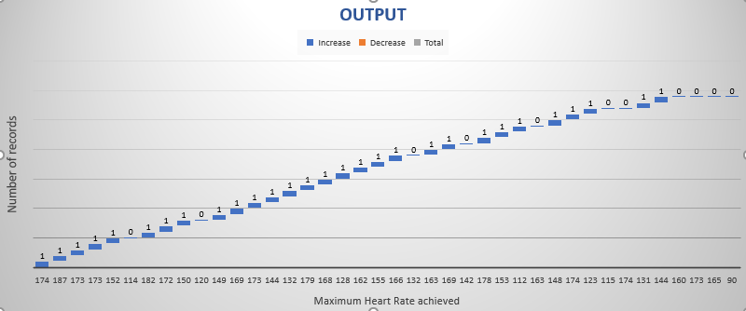
Relationship of Maximum Heat rate with Chances of Heart Attack

Slide 11
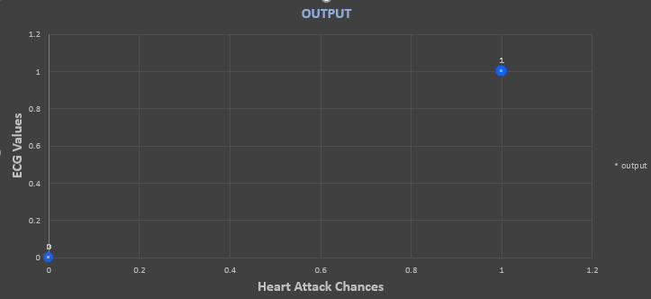
Relationship between ECG values and Chances of Heart Attack

Slide 12
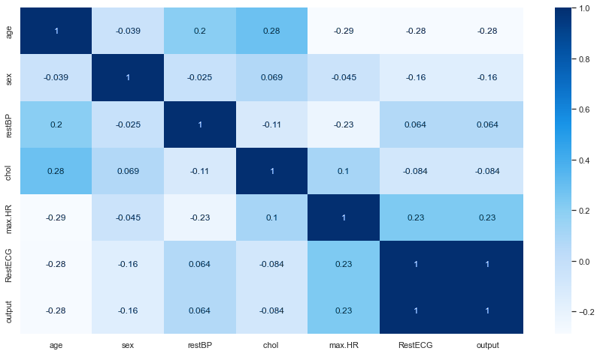
Correlation of the Dataset

Slide 13





Tools and Technologies
This Photo by Unknown Author is licensed under CC BY-NC
This Photo by Unknown Author is licensed under CC BY-SA
This Photo by Unknown Author is licensed under CC BY-SA

Slide 14



Coclusion
This Photo by Unknown Author is licensed under CC BY-SA
This Photo by Unknown Author is licensed under CC BY
This Photo by Unknown Author is licensed under CC BY

Slide 15

END
This Photo by Unknown Author is licensed under CC BY-NC

